Slide 1
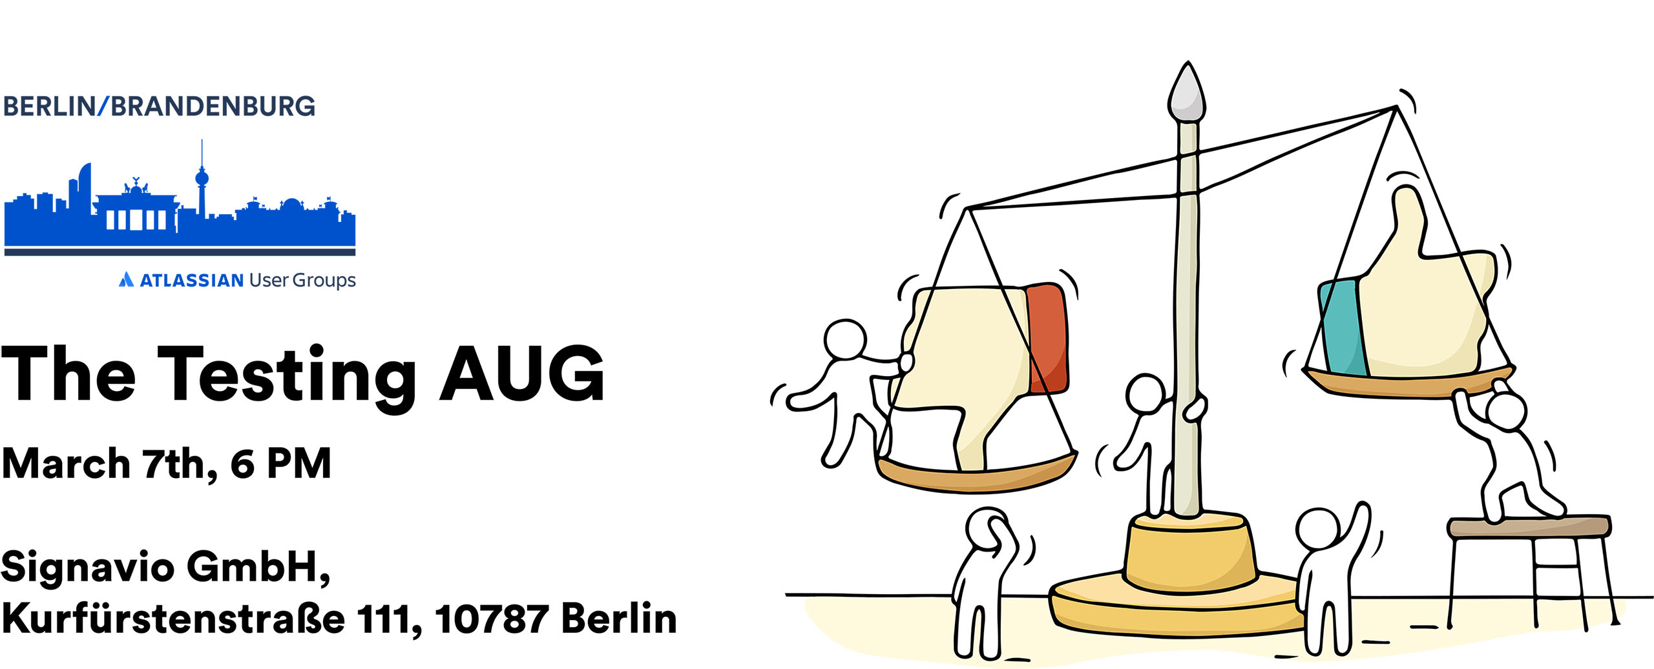
Welcome!

Slide 2
Thank
You!
For feeding and clothing us and giving us something to talk about:
For the room with a view and plenty of liquids:
For the topic and material support:
For unwavering support

Slide 3
Agenda
Atlassian User Group Berlin-Brandenburg

Slide 4
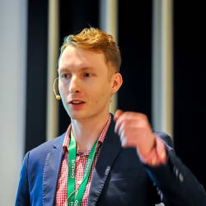
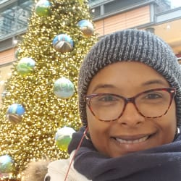
Welcome
and AUG News Hubert Kut,
Khallai Taylor

Slide 5
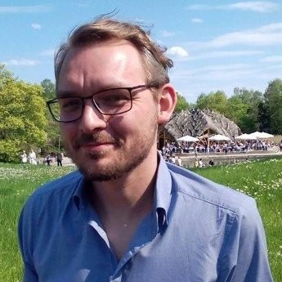
Welcome and a few words from our host Marcel Draheim,
Signavio

Slide 6
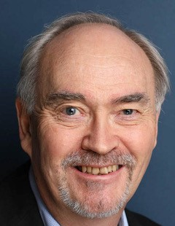
Testing for compliance in automotive development with Jira and Xray Irwin Fletcher,
OpenSynergy

Slide 7
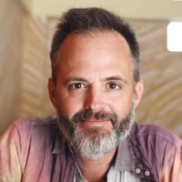
End-to-End Testing of Atlassian Products with Xray, Cucumber and Selenium/Browserstack Michael Schmidt,
re:solution

Slide 8
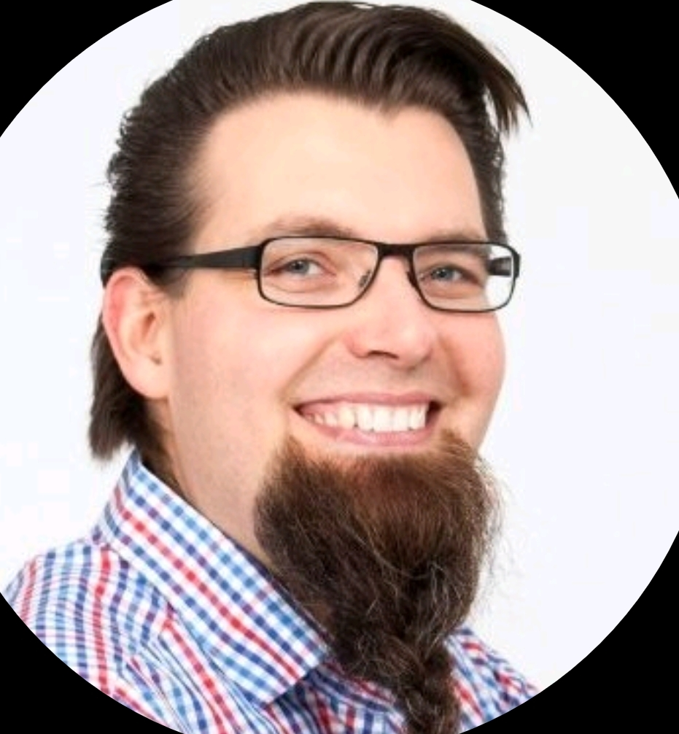
Growing QA Processes in Startup Environments Nils Balkow-Tychsen,
humanitec

Slide 9
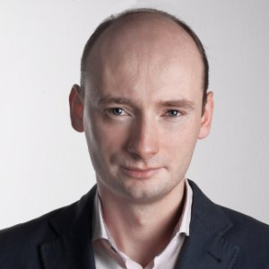
How does a testing tool support its own development - real-life examples Bogusław Osuch,
Deviniti

Slide 10
Next Event:
May 7th, 2019
Mini Summit

